Slide 1
November 26, 2020 (16.40 – 18.40)
the taboos that you shouldn't break when you are talking on the phone
www.chrisbauman.com.au

Slide 2
Warmup Classroom Activity
Find you teammate for today and introduce your friend
What is your name?
Who is your best friend?
How did you meet your best friend?
Are you taller that your best friend?
Where is your best friend from?
What do you like to do with your best friend?

Slide 3
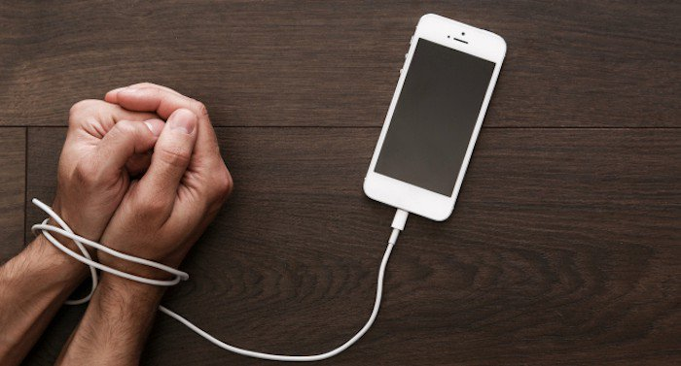
Initial Discussion
www.chrisbauman.com.au

Slide 4
Agenda
Body language shapes who we are (How we communicate)
Cellphone Etiquette
Relationships
Tips
Addiction
Numbers
Emoji Icons
Privacy
Switching off
www.chrisbauman.com.au

Slide 5
Body Audit (posture)
Smaller
Crossing your legs
Wrapping your ankles
Spread out
Crossing your arms
Facial expression
What is your body language communicating?
Discuss
Slide 4 – 8 body language
www.chrisbauman.com.au

Slide 6
The body language of others
www.chrisbauman.com.au

Slide 7
In face to face conversation there is more information available
www.chrisbauman.com.au

Slide 8
www.chrisbauman.com.au

Slide 9
www.chrisbauman.com.au

Slide 10
We do the opposite of others
www.chrisbauman.com.au

Slide 11
Psychology
1. Our minds change our bodies
2. Our bodies also change our minds
www.chrisbauman.com.au

Slide 12
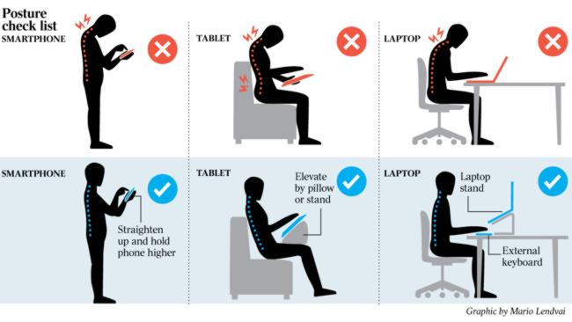
www.chrisbauman.com.au

Slide 13
Is cellphone use part of our body language?
www.chrisbauman.com.au

Slide 14
There are two audiences for non-verbal queues
Other people: (outcome)
Our thoughts, feelings and physiology are influenced by our non-verbal language
Ourselves:
Do our non-verbals govern how we think and feel about ourselves? Hence, they affect the way that we communicate with each other.
www.chrisbauman.com.au

Slide 15
Cellphone Etiquette
https://youtu.be/la1lRcq2-LU
What is the company policy in relation to the use of mobile phones?
Do cellphones help build strong interpersonal relationships?
What message do you send when you put your phone away while interacting with others?
www.chrisbauman.com.au

Slide 16
When are relationships built?
During the times that your cellphone
is out of sight.
www.chrisbauman.com.au

Slide 17
“Conversational competence might be one of the biggest skills that the educational system fails to teach”
Communicating through screens
Text
Email
Instant message (IM)
Social media
What happened to –
face to face interaction?
www.chrisbauman.com.au

Slide 18
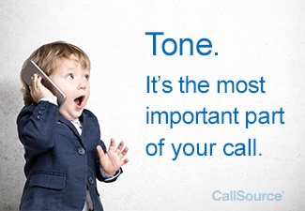
1. Don’t multi-task (be present)
10 rules

Slide 19
2. Don’t pontificate (opinion without feedback)
10 rules
Enter every conversation assuming that you have something to learn. True listening means setting aside one’s self. “Being a great conversationalist is being a good listener” Dale Carnegie.

Slide 20
3. Ask open ended questions
10 rules

Slide 21
4. Don’t let your mind drift and attempt to incorporate the thought (let these thoughts go).
10 rules

Slide 22
5. If you don’t know - then say that you don’t know
10 rules

Slide 23
6. Don’t equate your experience with theirs….don't try and say how the same thing happened to you
10 rules

Slide 24
7. Don’t repeat yourself over and over
10 rules

Slide 25
8. Avoid too many small details
10 rules

Slide 26
9. Listen actively. Listen to understand, not just reply.
10 rules

Slide 27
10. Be Brief – Short enough to gain interest, but long enough to cover the subject
10 rules

Slide 28
How to win friends and influence people
How do you share information?
How do you cooperate?
How do you show a genuine interest in other people?
How do you remember peoples’ names?
https://youtu.be/wtNOq1Bwtt4 (4min)
www.chrisbauman.com.au

Slide 29
“Everyone has some hidden amazing thing about them” and with better listening we can find it.
www.chrisbauman.com.au

Slide 30
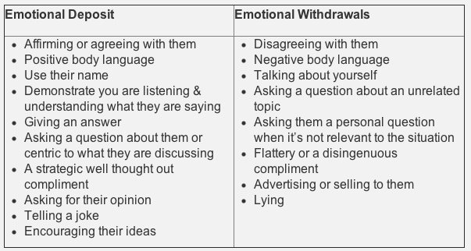
www.chrisbauman.com.au

Slide 31
Phone Tips
1. Choose a quiet space.
Maintain focus and avoid distraction.
If children are around or sleeping, they can become unpredictable distractions.
Avoid places like the outdoors, your car, or any other noise-prone area.
Telecommuting requires a quiet space to work
www.chrisbauman.com.au
https://www.flexjobs.com/blog/post/5-tips-successful-phone-interview-v2/

Slide 32
Phone Tips
2. Remove other distractions
What other things can distract you when you are trying to work?
www.chrisbauman.com.au
https://www.flexjobs.com/blog/post/5-tips-successful-phone-interview-v2/

Slide 33
Phone Tips
3. Outline your talking points
Where do you write the notes that you prepare?
How do you set out your notes?
Be prepared (have pertinent information at your fingertips)
Take notes
www.chrisbauman.com.au
https://www.flexjobs.com/blog/post/5-tips-successful-phone-interview-v2/

Slide 34
Phone Tips
4. Consider what you wear
Dress for success
Be confident
www.chrisbauman.com.au
https://www.flexjobs.com/blog/post/5-tips-successful-phone-interview-v2/

Slide 35
Phone Tips
5. Smile
Your smile can come through in your voice
It can also calm your nerves
Try saying
– I am going to get this sale
- I am going to get this sale (while smiling) …. This elevates your voice
Small team activity
www.chrisbauman.com.au
https://www.flexjobs.com/blog/post/5-tips-successful-phone-interview-v2/

Slide 36
Phone Tips
6. Body Language.
We mentioned this above
Sitting up straight,
don’t fidget with your hands,
manage your breathing
www.chrisbauman.com.au
https://www.flexjobs.com/blog/post/5-tips-successful-phone-interview-v2/

Slide 37
Phone Tips
7. Don’t interrupt
Give more time than you would normally after a person has finished speaking to ensure they’re done
www.chrisbauman.com.au
https://www.flexjobs.com/blog/post/5-tips-successful-phone-interview-v2/

Slide 38
Phone Tips
8. Ask Questions
Have some questions prepared
Sample interview questions
What makes it really good day?
What makes it a challenging day?
What does a successful employee look like to you?
How will my work performance be evaluated?
www.chrisbauman.com.au
https://www.flexjobs.com/blog/post/5-tips-successful-phone-interview-v2/

Slide 39
Phone Tips
9. Follow up
Send a thank you note
Send a thank you email (to who?)
Include
Time
Add a couple of main points
Reiterate your enthusiasm
www.chrisbauman.com.au
https://www.flexjobs.com/blog/post/5-tips-successful-phone-interview-v2/

Slide 40
Phone Tips
Phone Tips
10. Uncomfortable pauses
Don’t talk through the moments of silence
www.chrisbauman.com.au
https://www.flexjobs.com/blog/post/5-tips-successful-phone-interview-v2/

Slide 41
Addiction
https://youtu.be/PMEqLzWrMIo
www.chrisbauman.com.au

Slide 42
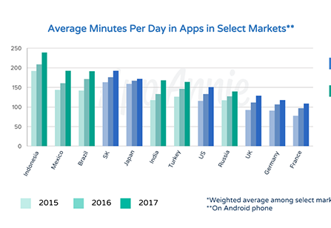
How many apps on your cellphone vie for your attention?
www.chrisbauman.com.au

Slide 43
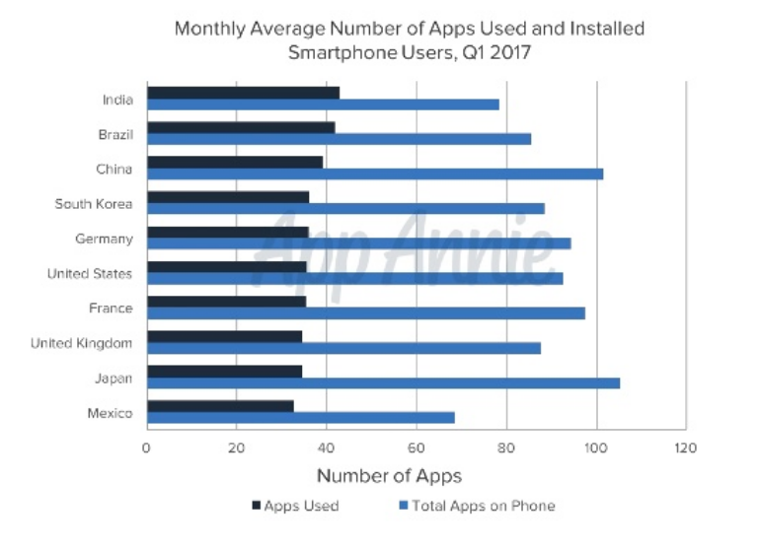
www.chrisbauman.com.au

Slide 44
Emoji Icons
Used well in online negotiations can lead you to be able to claim more value from a negotiation
If used poorly…. Not a good idea, right?
How do you use them?
www.chrisbauman.com.au

Slide 45
Privacy Tracking your mobile phone - business - government Why do it? Yes or no?
https://www.washingtonpost.com/business/2020/04/23/offices-after-coronavirus/
www.chrisbauman.com.au

Slide 46
Switching off after work
https://www.siliconrepublic.com/advice/switch-off-work-mode-how-to
Leave some work off your mobile
Turn off push notifications
Minimize work chat at home
Be present with others
Develop an evening ritual
www.chrisbauman.com.au

Slide 47
Communication is what makes a strong team
www.chrisbauman.com.au

